Slide 1
Welcome and please sign in on the clipboard before you leave!
MOUNT AUBURN
PRACTICE IMPROVEMENT PROGRAM
(MA-PIP)
Practice Managers Session
July 9, 2015

Slide 2
Today
The Mount Auburn Practice Improvement Program
Patient safety in Office Practice/Ambulatory Care
Science of Patient Safety:
Systems thinking and Safety culture
Effective improvement strategies:
  The Model for Improvement

Slide 3
Ground Rules
There are no dumb questions
Ask a question at any time – you are helping your colleagues – someone else was wondering too – sometimes I’m not clear
It’s alright/it’s important to admit any problem – that’s the point of the project – team will find a way to address
We are repeating slides – to reinforce the learning

Slide 4
Introductions
How many are practice managers? Who else?
How many able to attend May 8?
How many able to attend June 11?
How many were able to watch the video lecture? Not?

Slide 5
Mount Auburn Practice Improvement Program (MA-PIP): Why now?
Improving patient safety in office practice/ ambulatory care
Enable your practice to improve your work while you do your work –
    Engaging practice staff to “see problems and solve problems”
Build on proven model – PROMISES program
Hardwire & integrate with current ambulatory patient safety program
Notes:
Enabling your practice to improve without disrupting patient care
- Skills to be a learning organization
- Engaging all practice staff to “ see problems and solve problems”
- Same approach can improve patient safety, quality, patient experience, efficiency
- Makes work more manageable
Accelerating Improvement in Healthcare &
“ Leader-led Learning: the great differentiator”
Steve Spear

Slide 6
Mount Auburn
Practice Improvement Program
Two year partnership:
  Teach practice leaders and staff techniques to make care safer
Train practice managers/clinicians/staff in patient safety principles, quality improvement techniques
  Video learning modules & meetings/webinars
  Community Learning Sessions for clinicians and staff
Train two MAPS directors as coaches to work with teams from selected Mount Auburn office practices to practice these approaches
  Start with two practices
  Expand over time
Notes:
Builds on the PROMISES learning
A collaboration to build a quality improvement infrastructure within Mount Auburn
Trained coaches ( Sonya Sullivan, Susan McDonnell working directly with practices – also Lora Gross-Kostka)
Trained practice managers
Create an ongoing learning environment for MAPS & MACIPA practices
As we work together - will discuss INTEGRATION WITH OTHER PROGRAM _ ONE PATIENT SAFETY PROGRAM

Slide 7
MA-PIP Team
Mount Auburn
Chuck Lukasik
Yvonne Cheung
Margaret Martello
Lora Gross-Kostka
Susan McDonnell
Sonya Sullivan
MA Coalition
Paula Griswold
Beth Capstick
Judy Ling
Emily Biocchi

Slide 8
MA- PIP Practices with Coaches
Mount Auburn Medical Associates
Physician Leader: Dr. Andrew Cutler
Practice Manager: Sandra DeFrancisco
Primary Care Center
Physician Leader: Dr. Linda Powers
Practice Manager: Laura Mahoney

Slide 9
Today
The Mount Auburn Practice Improvement Program
Patient safety in Office Practice/Ambulatory Care
Science of Patient Safety:
Systems thinking and Safety culture
Effective improvement strategies:
  The Model for Improvement

Slide 10
What is patient safety?
What do you worry about in your practice,
how might a patient be harmed?

Slide 11
Patient safety priorities in ambulatory care
Reliable processes –
  3 key areas for ambulatory safety:
  -Test result management
  -Referral Management
  -Medication Management
Plus Communication issues
– With patient, among staff, across settings
11
Notes:
From the literature – the most common contributing problems

Slide 12
The “Big 3” Key Processes
Test ordering & Results Management
  Handling critical results, communication to patient
Follow-up and Referral Management
  Ensuring reliable and timely referrals and f/up for potentially serious problems
Medication Management
  High risk meds, monitoring, CDS,
12
Notes:
CAN YOU GIVE ME AN EXAMPLE?

Slide 13
Improved communication
During patient care:
Among practice staff/care team members
Around 3 risk-prone key processes – across settings
  Lab test, referral, medication management
With patients during and between encounters
For improvement:
With patients/families after adverse event
Hearing patients’ concerns and ideas
13
Notes:
Among practice staff/ care team members
Culture of safety elements
Around 3 risk-prone key processes – across settings
Lab test, referral, medication management
With patients during and between encounters
Meeting patient’s needs during the visit - agenda
Shared decision-making; patient literacy/understanding
Working with difficult/challenging patients
With patient/families after adverse event
Hearing patients concerns and ideas
Inputs to improve safety

Slide 14
Today
The Mount Auburn Practice Improvement Program
Patient safety in Office Practice/Ambulatory Care
Science of Patient Safety:
Systems thinking and Safety culture
Effective improvement strategies:
  The Model for Improvement

Slide 15
Science of Patient Safety
Systems thinking
  Most problems do not result from individual workers; but from the design of work processes/system
Notes:
We don’t blame the people, we improve the system in which they work
Every system is perfectly designed to get the results it gets
Insanity is doing the same thing over and over and expecting diffferent results

Slide 16
Science of Patient Safety
Systems thinking
  Most problems do not result from individual workers; but from the design of work processes/system
  Making processes reliable
Notes:
We don’t blame the people, we improve the system in which they work
Every system is perfectly designed to get the results it gets
Insanity is doing the same thing over and over and expecting diffferent results

Slide 17
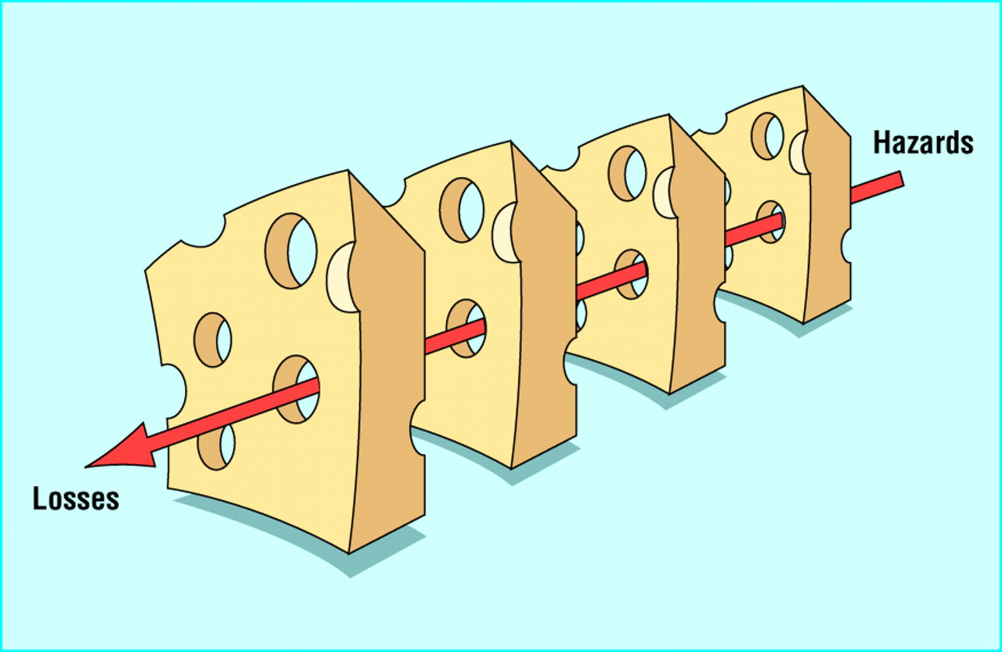
The Swiss Cheese Model of System Accidents
J.Reason, BMJ 2000;320:768-770

Slide 18
Take a moment to talk to one or two people next to you:
What are “unreliable” steps of the process in your practice that could harm a patient?

Slide 19
Science of Patient Safety
Systems thinking
Safety culture –
  ‘ the way we do things around here”
Notes:
We don’t blame the people, we improve the system in which they work
Every system is perfectly designed to get the results it gets
Insanity is doing the same thing over and over and expecting diffferent results

Slide 20
Characteristics of a
Culture of Patient Safety
Driving out fear so people aren't afraid to ask questions or share things that go wrong
Organizational emphasis on identifying unsafe conditions, taking steps to reduce risks to patients
Ensure that there is learning from mistakes
When dealing with adverse events, replacing blame and fear with learning and improvement.
Staff working together as a team
Good communication among staff
Leaders commitment to safety for patients and a culture of safety for staff
Notes:
Note the attached articles from Steve Spear – stapled into the presentation packet
It is the job of everyone in the practice to look for sources of risk to patients, to bring them to the attention of the team, and to work to fix them, BEFORE they hurt a patient
Look for “accidents waiting to happen”, and change the process to protect patients from harm

Slide 21
Science of Patient Safety
Systems thinking
Safety culture
  ‘ the way we do things around here”
  Leadership & values
  Teamwork & communication
  Trust, psychological safety
Notes:
We don’t blame the people, we improve the system in which they work
Every system is perfectly designed to get the results it gets
Insanity is doing the same thing over and over and expecting diffferent results

Slide 22
Today
The Mount Auburn Practice Improvement Program
Patient safety in Office Practice/Ambulatory Care
Science of Patient Safety:
Systems thinking and Safety culture
Effective improvement strategies:
  The Model for Improvement

Slide 23
Some ways not to improve
Try harder (faster, smarter…)
Be more vigilant/careful
Exhortation – Let’s do better!
Doing things the same way and expecting different results…

Slide 24

Model for Improvement
Aim
Measures
Changes

Slide 25
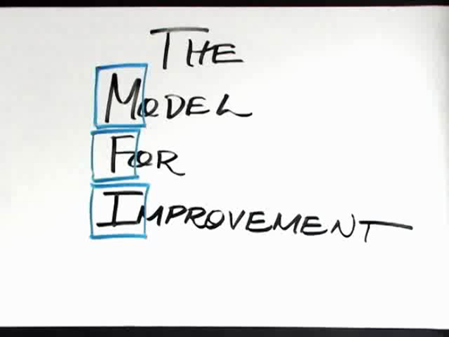
Short Videos
Model for Improvement - Parts 1&2
http://www.ihi.org/education/IHIOpenSchool/resources/Pages/AudioandVideo/Whiteboard3.aspx
http://www.ihi.org/education/IHIOpenSchool/resources/Pages/AudioandVideo/Whiteboard4.aspx

Slide 26
Model for Improvement
Aim
Measures
Changes
Developed by: Associates in Process Improvement
Test of Change
The Improvement Guide: A Practical Approach to Enhancing
Organizational Performance, 2nd Ed. Gerald J. Langley et al. Jossey-Bass April 2009
PDSA =
Notes:
Builds on Deming’s Theory and the scientific method
Based on the development, testing and implementing of changes
Heavily focused on learning from small scale tests – “trial-and-learning

Slide 27
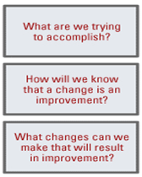
What Are We Trying to Accomplish? (Personal Aim)
What to improve?
For whom?
By when?
By how much?
My aim:
By Thanksgiving of this year,
I want to decrease the time spent working
past 5:30 PM ET from 180 to 60 minutes per day.
I want to increase my focus on:
(1) improving systems for triaging emails,
(2) improving systems for scheduling calls and meetings.
Quotes from Don Berwick speech, 2004

Slide 28
What Are We Trying to Accomplish?
Aim
Does this answer….
By March 2012 ( in two months), our practice will:
Improve the Rx refill process
Reduce phone calls from patients or pharmacies to verify or check on prescription refills
Reduce the duplicate prescription requests
Reduce these events by 50% in this time frame
What to improve?
For whom?
By when?
By how much?
Numerator and denominator

Slide 29
Talk to someone next to you
Think about the problems you talked about, pick one, and try to come up with an Aim statement
    What to improve?
    For whom?
    By when?
    By how much?
    Numerator and denominator

Slide 30
All together
Who is willing to share your Aim statement?
    What to improve?
    For whom?
    By when?
    By how much?
    Numerator and denomimator

Slide 31
Model for Improvement
Aim
Measures
Changes
Developed by: Associates in Process Improvement
Test of Change
The Improvement Guide: A Practical Approach to Enhancing
Organizational Performance, 2nd Ed. Gerald J. Langley et al. Jossey-Bass April 2009
PDSA =
Notes:
Builds on Deming’s Theory and the scientific method
Based on the development, testing and implementing of changes
Heavily focused on learning from small scale tests – “trial-and-learning

Slide 32
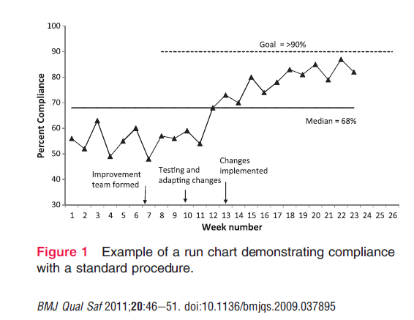
Measures of Improvement
How will we know that a change is an improvement?
Defining a measure(s) to track the impact of your changes

Slide 33
Model for Improvement
Aim
Measures
Changes
Developed by: Associates in Process Improvement
Test of Change
The Improvement Guide: A Practical Approach to Enhancing
Organizational Performance, 2nd Ed. Gerald J. Langley et al. Jossey-Bass April 2009
PDSA =
Notes:
Builds on Deming’s Theory and the scientific method
Based on the development, testing and implementing of changes
Heavily focused on learning from small scale tests – “trial-and-learning

Slide 34
Changes
What changes can we make that will result in improvement?
Team that knows/describes the current process – flow chart ( Post-it Notes!)
Consider ideas that might improve the process ( simplify/remove steps, checklists/don’t rely on memory, etc.)

Slide 35
Tests of Change: The PDSA Cycle for
Learning and Improvement
Act
Plan
Adapt?
Adopt?
Abandon?
What’s the
next cycle?
Objective Questions
& predictions (why).
Plan to carry out cycle
(who/what/where/when).
Next cycle?
Study
Do
Complete the
analysis of the data.
  Compare data to
  Predictions.
    Summarize what
    was learned.
Carry out the plan
(on a small scale).
Document problems
and unexpected
observations.
Begin analysis.
W.E. Deming referred to this as the Shewhart Cycle
Notes:
Using small scale tests of change to build knowledge and confidence in changes that you want to make permanent (it’s not that the changes you want to make are small, but you start your testing on a small scale – one patient, one day etc)
Using prediction and data to add rigor to the learning

Slide 36
Changes – Power of Small Tests
Try it once –
  One patient, one doctor
Start with a willing volunteer
What did you expect, what happened, what did you learn, what would you change?

Slide 37
Talk with a few people near you:
For the aim you discussed:
What SMALL change can you think of that you would test?

Slide 38
Review
For Safety
  Focus on systems, not people
  Work on a culture of safety
For improvement:
  Define a clear aim
  Use measurement and data for decision making
  Remember that improvement requires change
  Keep testing using PDSA cycles – keep tests small
For everything:
  Remember that customers are key
Notes:
38

Slide 39
Questions?
Comments?

Slide 40
Schedule for training
Next scheduled activities: Save the Dates
  Online training begins after this session
  Practice Managers:
    October 30
  Next Community Learning Sessions
    September 25 & December 4, 2015

Slide 41
Ambulatory Safety Course
14 Online sessions on the Mass. Medical Society Continuing Education website
Each module includes a 15-20 minute video and a quiz
List of sessions and directions on the handout
    Don’t worry - you don’t have to be a member & you don’t have to pay

Slide 42
Session Evaluation Forms
Everyone
We look forward to your feedback - will help us design future sessions
Please complete return to registration table!

Slide 43
Self Assessment Forms
For Practice Managers
  If you did not complete this yet
It’s not a test!
Please complete today and return to registration table

Slide 44
Thank you!
Notes:
To our presenters – Dr. Yvonne Cheung, Dr. Damian Folch, our coaching consultant Judy Ling
To our coaches and Mount Auburn partners – Chuck Lukahsik, Sonya Sullivan, Susan McDonnell, Lora Gross-Kostka ( Margaret Martello), and our thanks to Tracy Reeder
Our thanks to the practices that are starting after today with their coaches ( )
To Emily Biocchi – her skilled, calm, organization and preparation
Especially Beth Capstick, our Project Management and Improvement Consultant – managing everything
To all of you – for this important work to improve care and safety for patients

